Slide 1
JW JEOPARDY
By Nevin Ndonwi
Continue

Slide 2
What’s up guys
(Nevin, the creator, will keep score)
5 categories , 5 questions per category
There will be 5 daily doubles (5 questions are double the points) ☺ ☺ ☺
You will hate me by the end of this lol ☺
You get a question wrong, then you lose points (the amount the question was worth)
LET’S GO
Start

Slide 3
Categories
Name That Character
Mystery
Review
Bible book trivia
True or False
EXIT

Slide 4
Name That witness
300
100
500
200
400

Slide 5
Meeting review
300
100
500
200
400

Slide 6
TRUE OR FALSE
100
300
500
200
400

Slide 7
Mystery
100
300
500
200
400

Slide 8
Bible book trivia
100
300
500
200
400

Slide 9
TRUE OR FALSE (100 pts)
Satan wants to harm us and destroy us
True
False

Slide 10
TRUE OR FALSE (200 pts)
Satan is bad….
True
False

Slide 11

WOW Daily double
CONTINUE

Slide 12
TRUE OR FALSE (300 pts (600 with daily double) )
4/5 of these statements are true
1)Jesus is also called Michael
2)Jesus was Jehovah’s first creation
3)Jesus was a descendent of David
4)Jesus helped Jehovah to create the earth
5)Jehovah taught Jesus everything he knows.
True
False

Slide 13
TRUE OR FALSE (400 pts)
Jehovah never loved Satan
True
False

Slide 14
TRUE OR FALSE (500 pts)
(2/3) of these statements are true
1) The first creation of Jehovah started with “J”
2)Jesus knew where every dead body in the world was buried
3) Jehovah almost regretted making man (at one point)
True
False

Slide 15
WOW Daily double (100 * 2)
CONTINUE

Slide 16
Name that Witness (100 points)
1) Who is the brother of Vashti’s successor?
Ha ha nice try Nevin
Vashti’s successor didn’t have a brother
Mordecai DUHHHH
Haman
Elijah

Slide 17
Name that Witness (200 points)
1) Who was from Bethlehem
2) Who was from Ur?
Click the box correctly answering the questions
1 = Abram
2 = Jesus
1 = Michael
2 =Terah
1 = Mary
2= Abram
1 = Joesph
2 = Sarai

Slide 18
Name that Witness (300 points)
1)Who had more than ten children
2) Who is an Isrealite?
3) Who is imperfect?
Click the box that is correct
Isreal for all three questions
1 = Jacob
2= Sarai
3 = Adam
None of the other options are correct
Moses for all three questions

Slide 19
Name that Witness (400 points)
1)Helped God’s Son preach
2) Had the abilities of the “Jesus Christ Lizard”
3)Loved Jehovah with full dedication
4)Was associated with Fishermen
Which box correctly answers all four questions?
Jesus for all 4
1-2 = John
3-4= Andrew
1 and 3 =Judas I.
2 and 4 =Peter
Peter for all 4

Slide 20
Name that Witness (500 points)
1)Who was the killer of Sisera?
2)Who was the wife of Heber the Kenite?
3)Who knows the location of Moses corpse?
4)Who was a Jewish orphan girl ?(name means myrtle)
5)Who is named after a bible book?
Which box correctly answers all five questions?
1 and 2= Jael
3 = Jah
4=Esther
5= Moses
1 and 2 = Jael
3 = Jah
4= Haddassah
5= John
1= Jael
2= Bathsheba
3= Jesus
4= Esther
5= Mark
1 and 2 = Deborah
3= The God of Isreal
4 = Esther
5= Matthew

Slide 21
Bible book trivia (100 points)
Which name is used most in the bible
John
God
Jehovah
Jesus

Slide 22
Bible book trivia (200 points)
Who wrote the most bible books?
Moses
John
Paul
Peter

Slide 23
Bible book trivia (300 points)
(fill in the blank) The writer of _________ also split the waters of the ____________.
Judges ,Jordan river
Judges, Jordan river
Exodus, Nile
Genesis, Red Sea

Slide 24
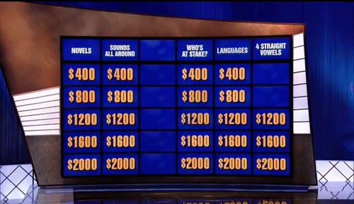
WOW Daily double
Continue

Slide 25
Bible book trivia( daily double )400 now: 800 points
In what year did the french “New world translation” come out?
2018
2020
1914
2019
1983
Joke is on you Nevin, It isn’t out yet
2005

Slide 26
Bible book trivia (500 points )
Which statement is NOT true
A Judge wrote Judges
John wrote John in Ephesus
Romans was written in Rome by a Roman
An Apostle wrote Acts
Mark wrote Mark in Rome

Slide 27
Meeting review (100 points)
What does the rider of the black horse in revelation 4-6 signify?
He signifies famine
He signifies death
He signifies sickness
He signifies love

Slide 28
WOW Daily double (200 * 2)
CONTINUE

Slide 29
Meeting review (200 points)
What should we do with our life today?
Nothing
EAT, DRINK, DIE, AND MAKE SOME BABIES #YOLO
Multiply and fill the earth for Jehovah
Preach the word

Slide 30
Meeting review (300 points)
What do the riders of the red horse(or fiery colored horse) , pale horse, and white horse signify?
Red horse = War
Pale horse = Sickness
White horse =
Michael
Red horse = War
Pale horse = Covid19
White horse =
Jesus
Red horse =
Civil war
Pale horse =
Black death
White horse =
Satan
Red horse = WW1
Pale horse =
Cholera
White horse =
Jesus

Slide 31
Meeting review (400 points)
What will happen to Babylon the great?
She will die
She will be humiliated
She will be loved
Blue and purple are both correct

Slide 32
Meeting review (500 points)
Which is most valuable to Jehovah?
The sheep
The fine flour
The sparrows
The goats

Slide 33
Mystery for 100 points
What is “God” in French?
Bete
Dieu
Dios
Fou

Slide 34
Mystery for 200 points
What is God in Chinese?
神
하느님
神
אלוהים

Slide 35
Mystery for 300
Choose which equation will result in the amount of languages JW.org is translated in.
More than:
(10) X (10) x (10) x (10) /10
Less than:
(10) X (10) x (10) x (10) /10
About : (10) X (10) x (10) /10
Approximately the remainder of 3001000/1500

Slide 36
Mystery for 400 points
What is the amount of books in the bible – 60 in Spanish?
seis
siete
sei
six

Slide 37

WOW Daily double
CONTINUE

Slide 38
500 (with daily double 1000 points)
Which language is not in Google translate but is in Jw.org ?
Ajie
Xhosa
Shona
Odia

Slide 39
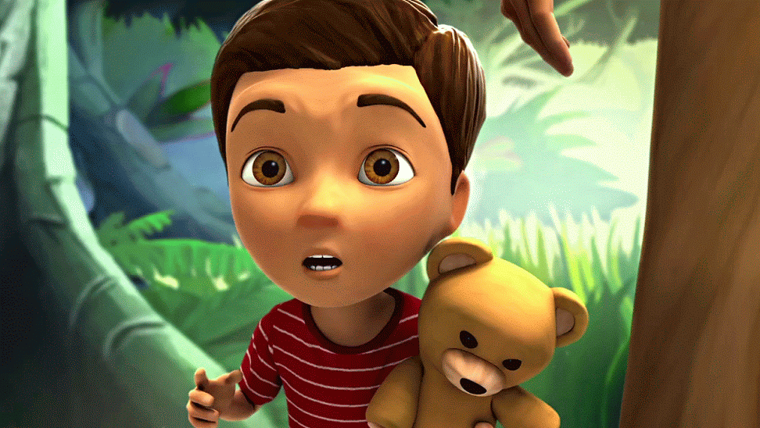
YAY you got it right ☺ ☺
YOU ARE
Awesome
Back to menu

Slide 40
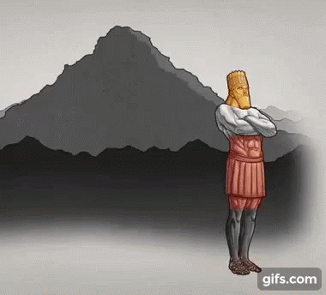
NOOO you got it wrong ☹ ☹
You got it wrong
oof
Back to menu

